Slide 1
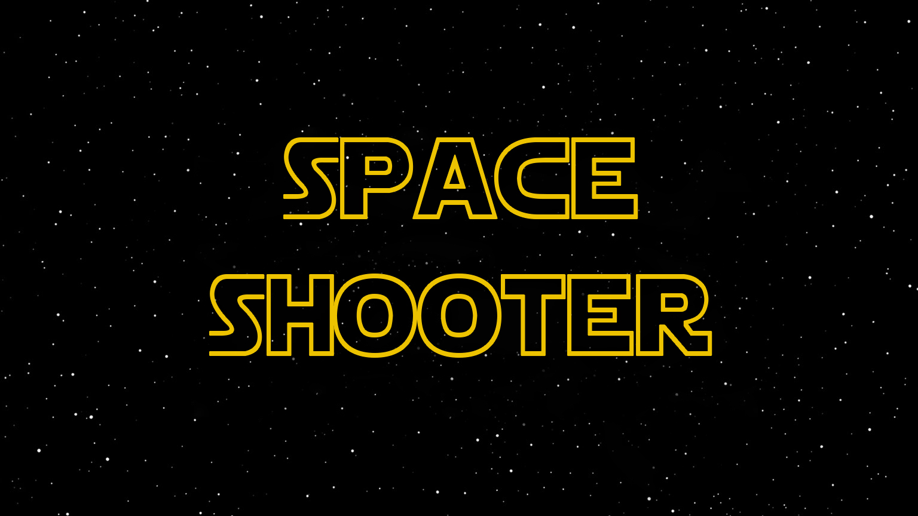

Slide 2
Theme
Fly through space
Shoot enemies
Gain points
Survive with 5 lives for as long as possible
Beat the high score

Slide 3
Functions
Interactive Menu
Different environments
High Scores
Randomized Enemies
Gradual Increase of Difficulty

Slide 4
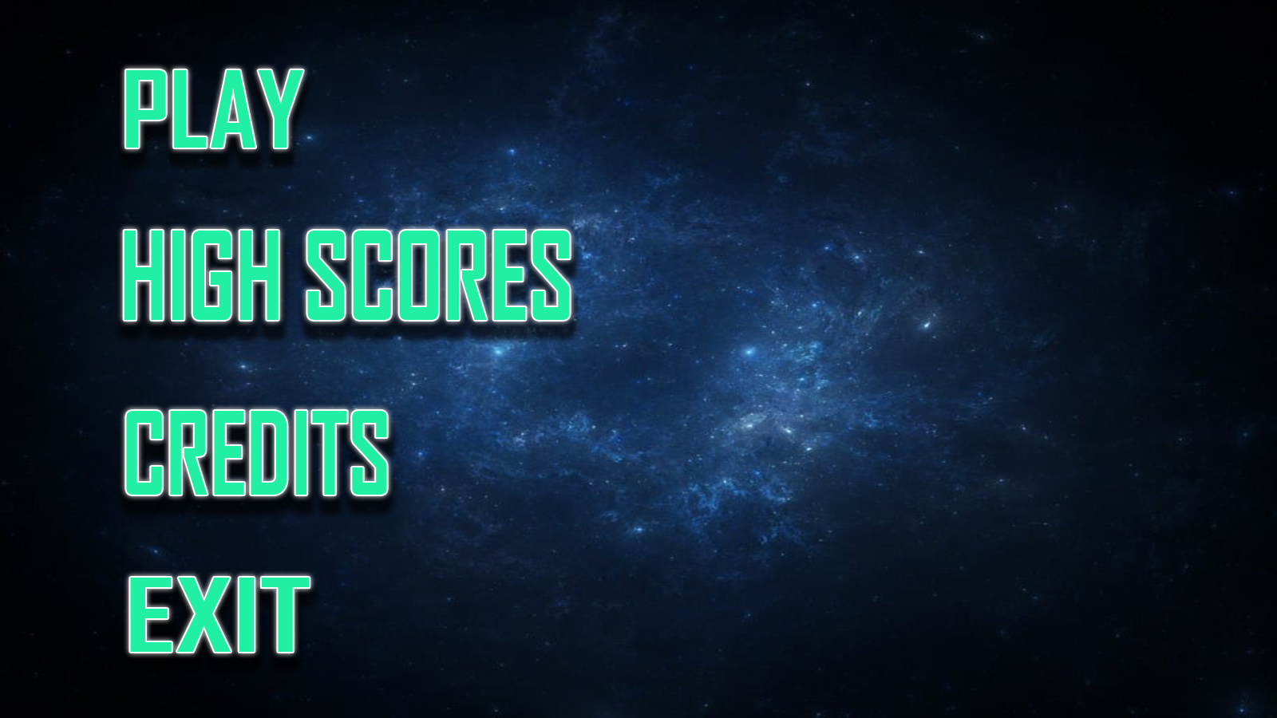
Menu

Slide 5
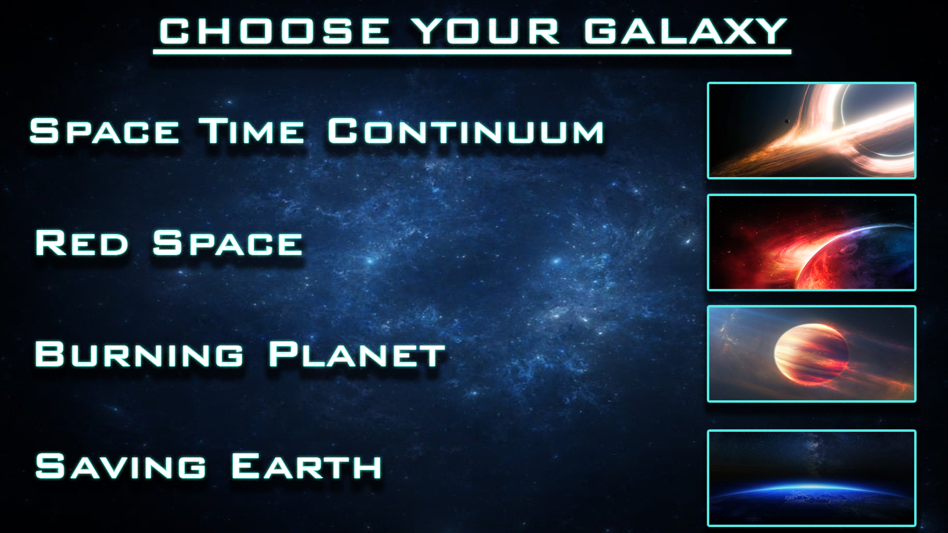
Levels

Slide 6
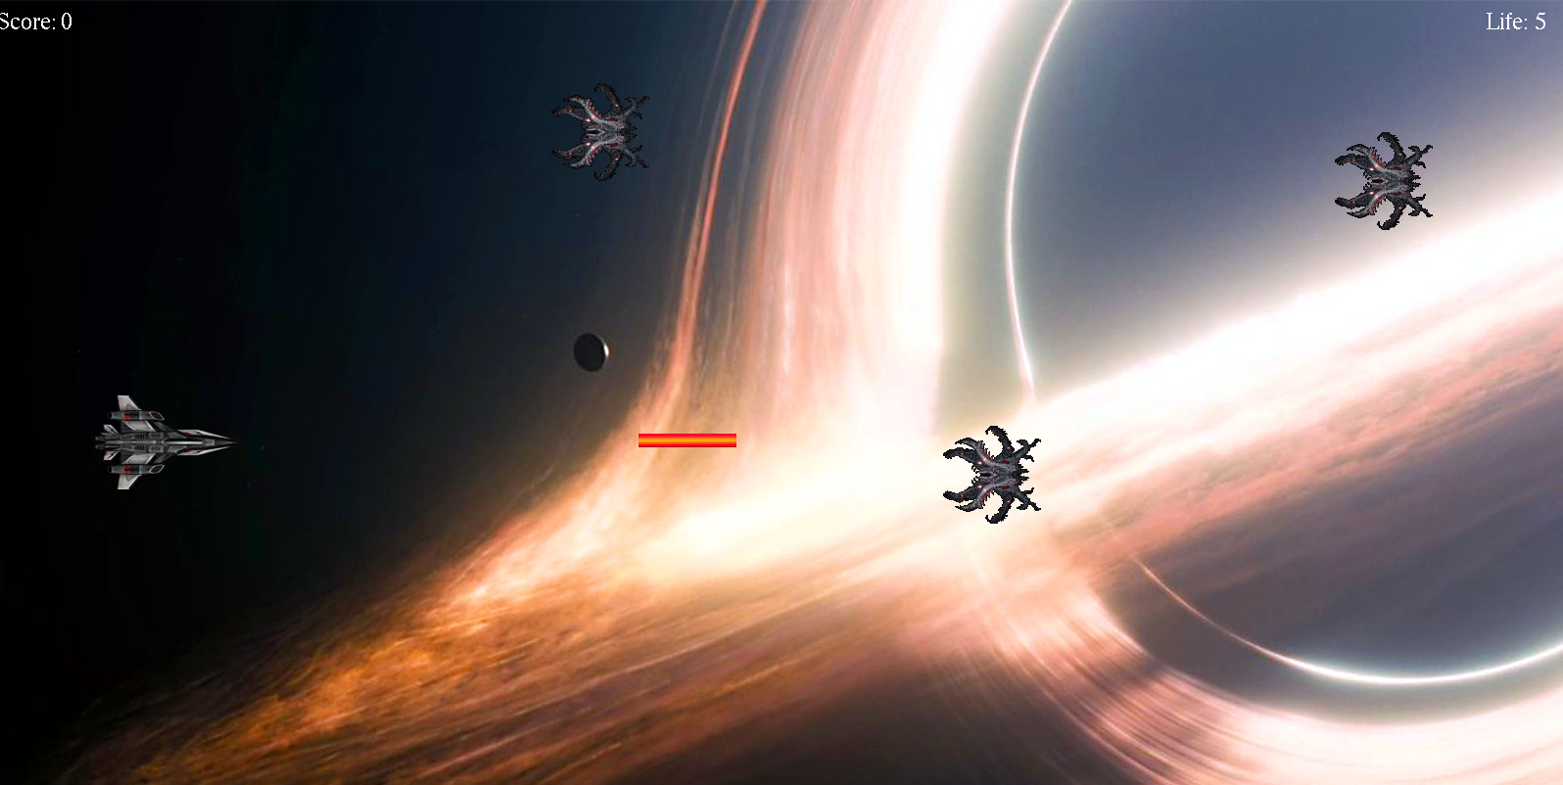

Slide 7
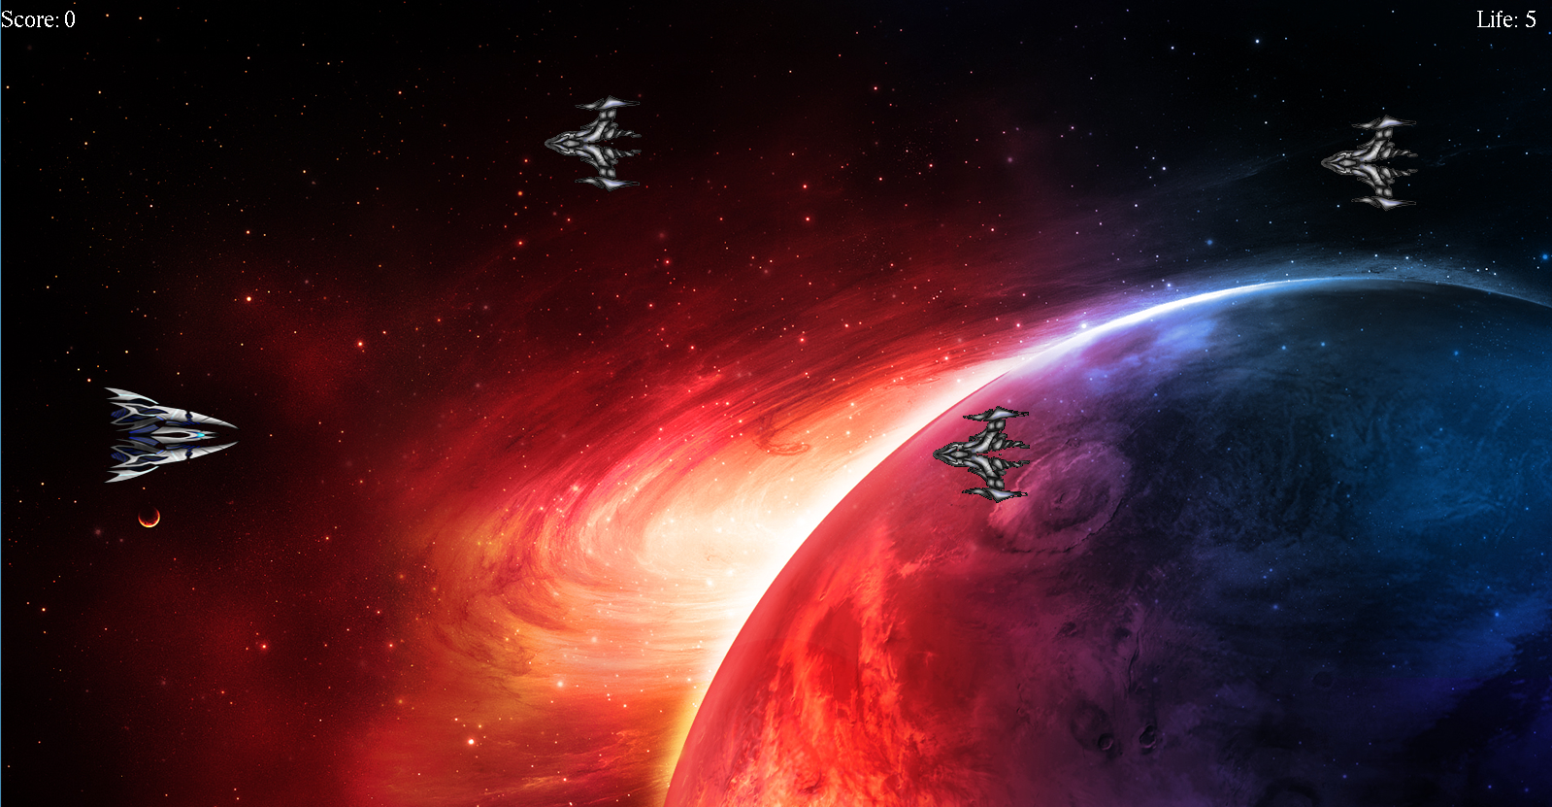

Slide 8
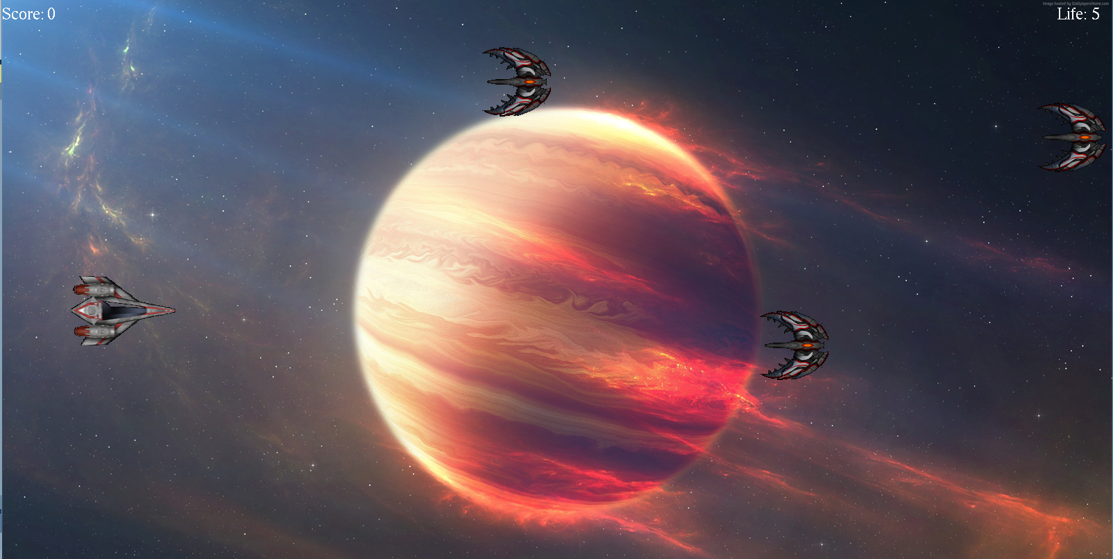

Slide 9
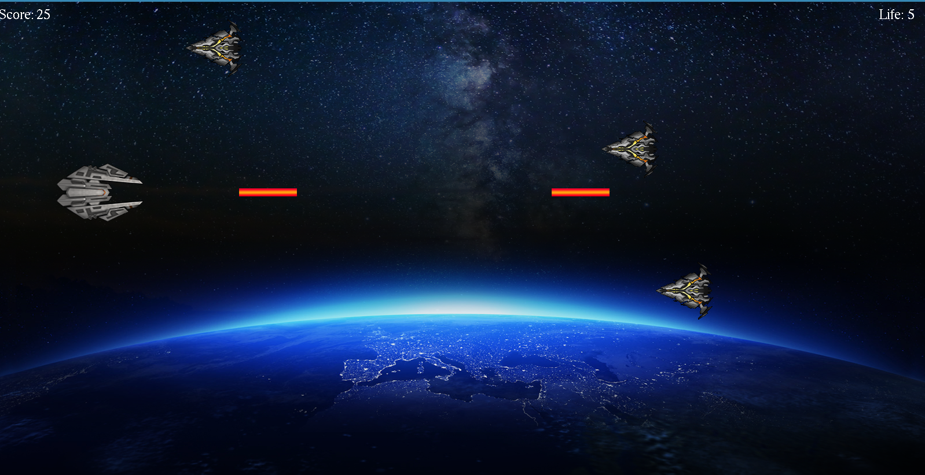

Slide 10
Key Algorithms
Randomized Enemy Movement
Spacecraft vs
Enemy
Collision
Enemy vs Laser Collision
Gradual increase of Difficulty

Slide 11
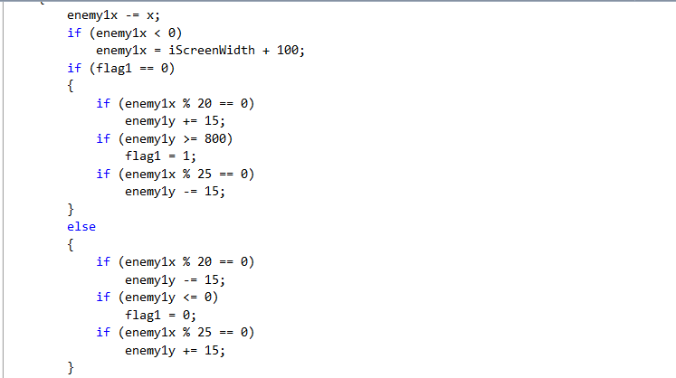
Randomized Enemy Movement

Slide 12
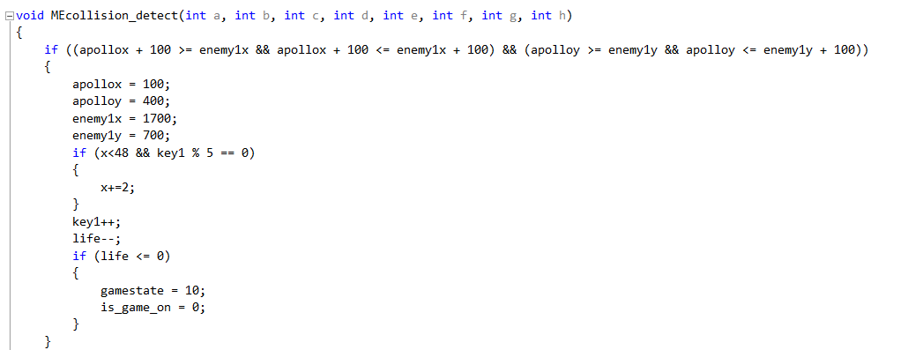
Spacecraft vs Enemy Collision

Slide 13
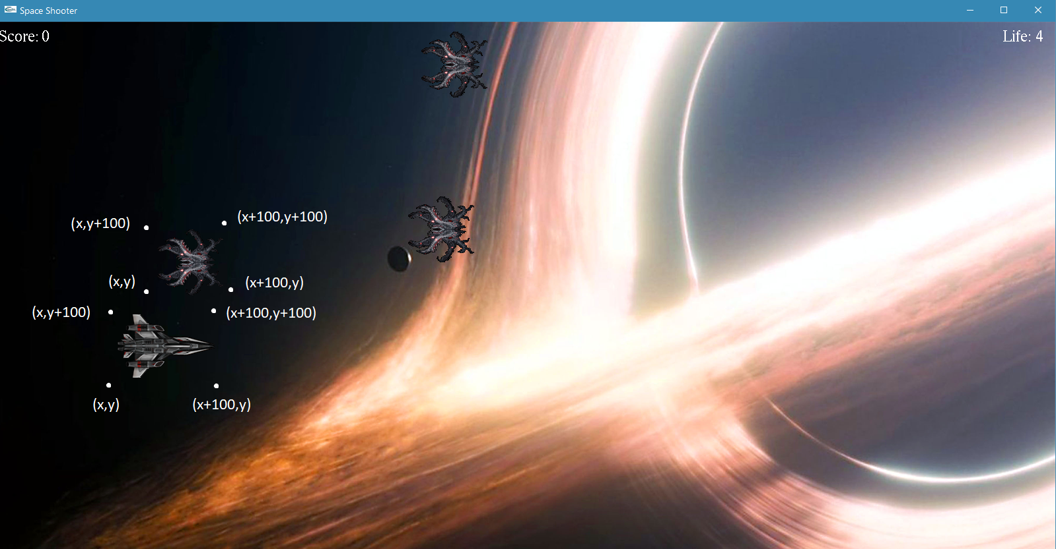

Slide 14
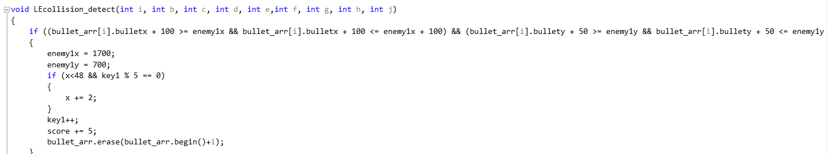
Laser vs Enemy Collision

Slide 15
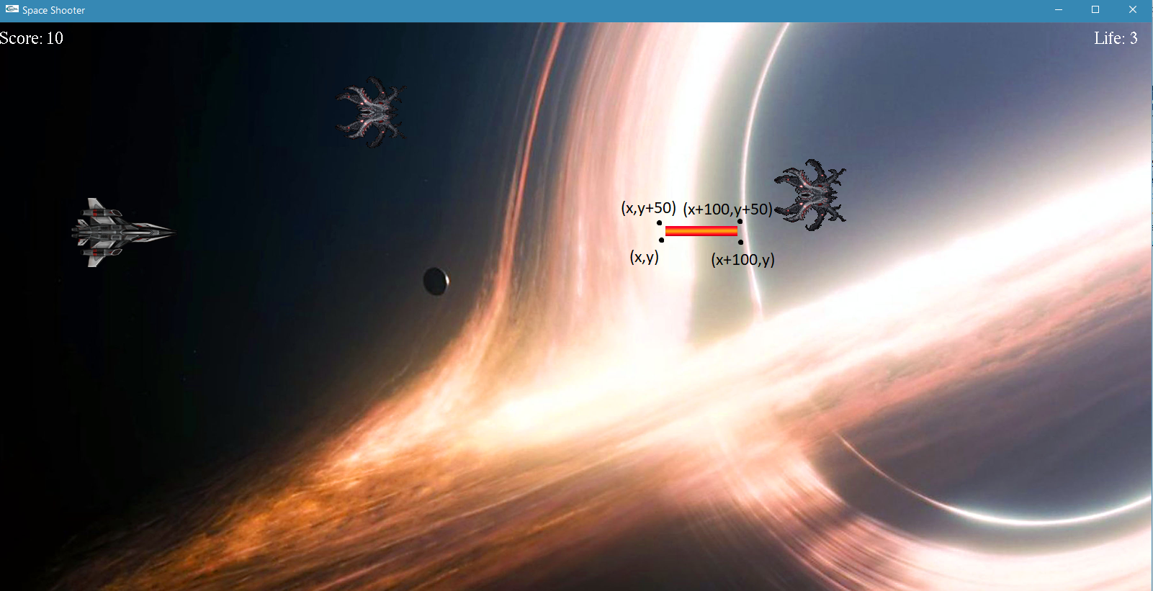

Slide 16
Gradual Increase of Difficulty
Each time an enemy is killed, the key value increases
Every time the key value reaches five, the speed increases by two units
The movement of enemy changes after each time it collides

Slide 17
Additional Functions
Pause Menu
High Scores
Showing scores on the screen
Showing health on the screen

Slide 18


Slide 19
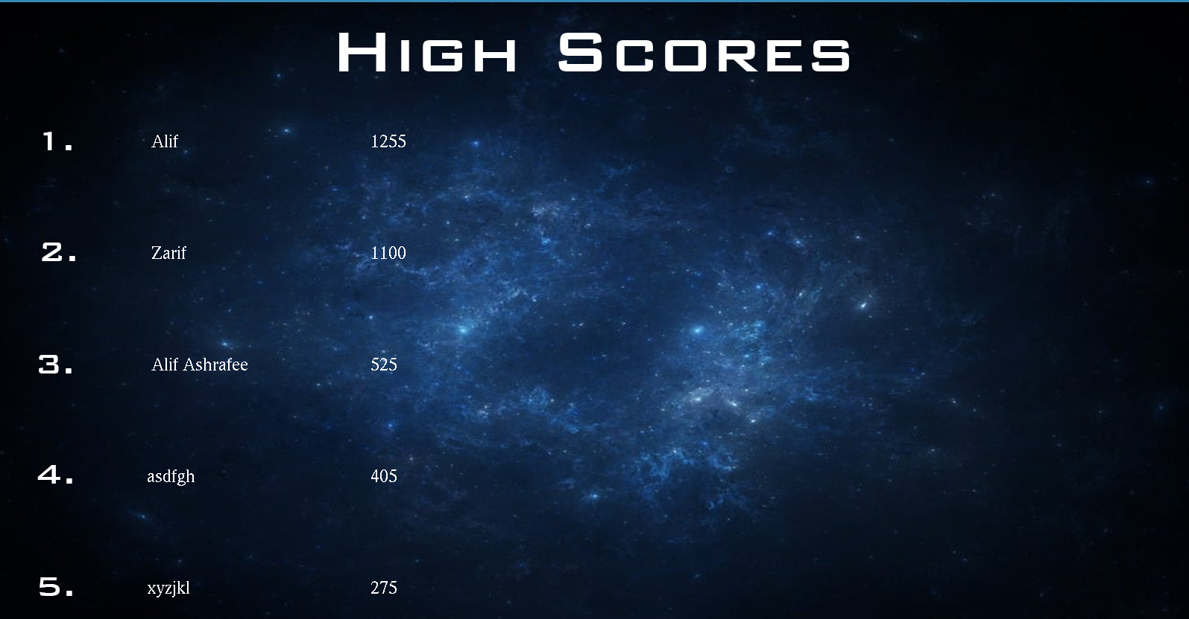

Slide 20
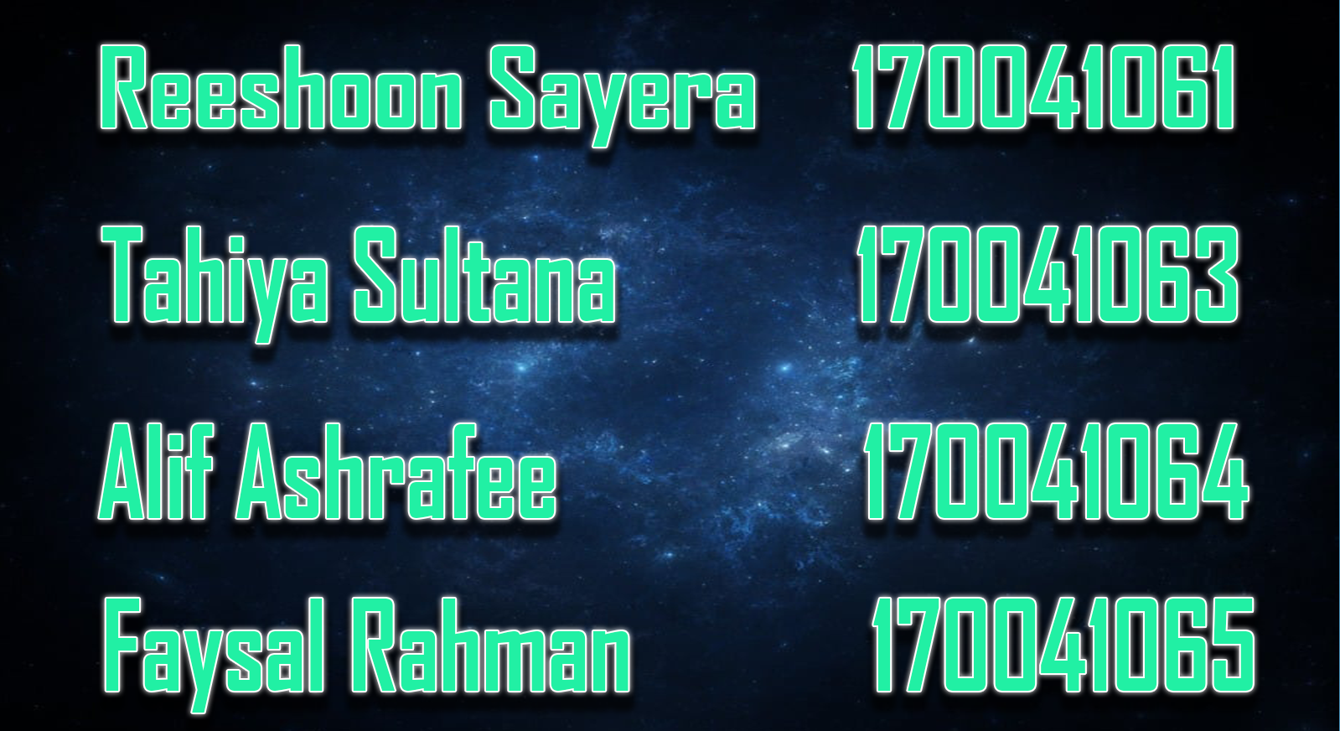

Slide 21
Thank you

